Slide 1


Data Collection & Preprocessing & Exploratory Data Analysis (EDA)
This presentation covers key steps in preparing data for sentiment analysis. Tasks covered:
Identifying and sourcing relevant datasets
Cleaning and handling missing values
Feature selection and engineering
Ensuring data integrity and consistency
Summary statistics and insights
Identifying patterns, trends, and anomalies
Handling outliers and data transformations
Initial visual representation of key findings

Slide 2
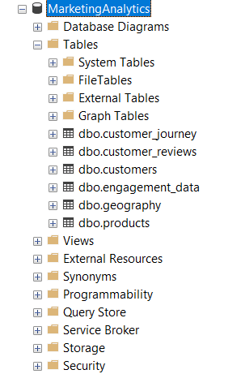
1. Identifying and Sourcing Relevant Datasets
Focused primarily on customer_reviews for sentiment analysis.
Tables: customer_reviews, customers, products, geography, customer_journey, engagement_data.
Imported six tables from MarketingAnalytics SQL database.

Slide 3
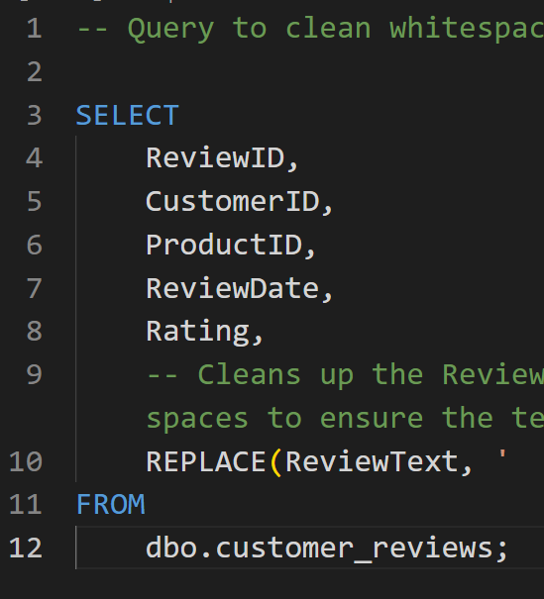
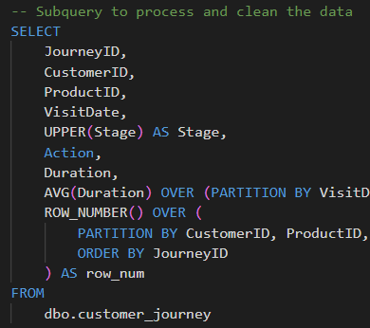
2. Cleaning and Handling Missing Values
Ensured all sentiment fields were populated before analysis.
Used SQL WHERE clauses to exclude NULL ReviewText or Rating records.

Slide 4
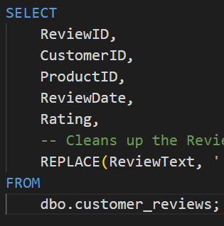
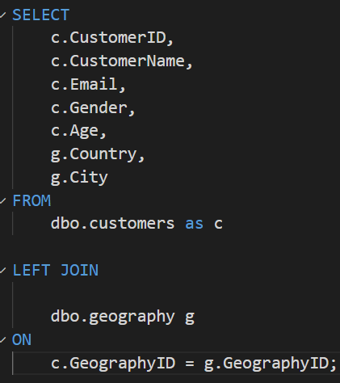
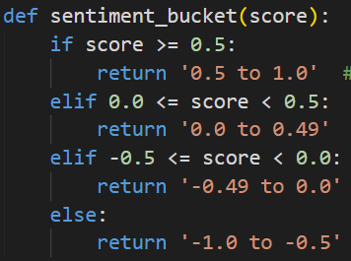
3. Feature Selection and Engineering
Engineered SentimentScore using VADER, SentimentCategory, SentimentBucket.
Selected key fields: ReviewID, CustomerID, ProductID, ReviewDate, Rating, ReviewText.

Slide 5
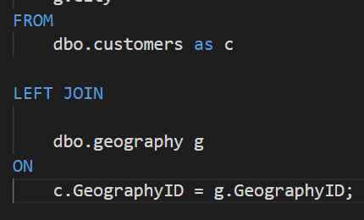
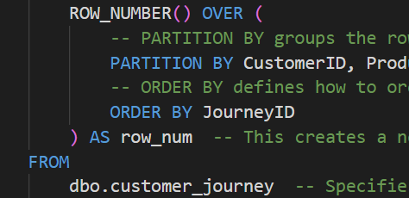
4. Ensuring Data Integrity and Consistency
Applied SQL JOINs and DISTINCT to avoid duplicates and mismatches.
Verified data types and consistency across joins and tables.

Slide 6
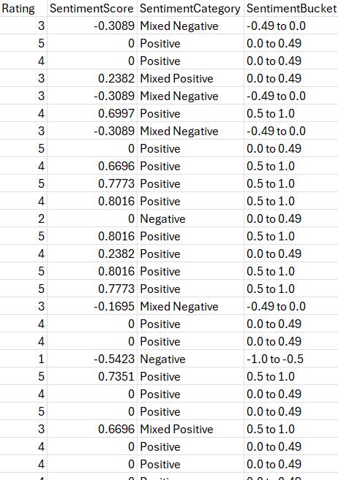
5. Summary Statistics and Insights
Ratings cross-compared with sentiment to infer true customer emotions.
Most reviews clustered near neutral (~0.0) sentiment score.
Sentiment scores ranged from approximately -0.6 to +0.8.

Slide 7
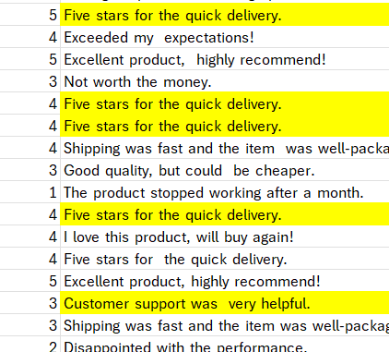
6. Identifying Patterns, Trends, and Anomalies
Observed a sharp central peak in sentiment distribution for neutral reviews.
Positive sentiment did not always align with high ratings, showing mixed feedback.

Slide 8
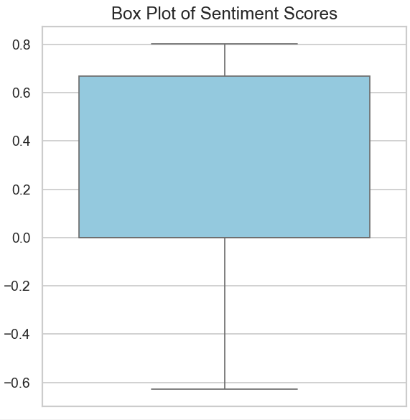
7. Handling Outliers and Data Transformations
No review texts were removed; outliers informed filtering strategy.
Flagged extreme sentiment scores below -0.5 or above 0.5 using buckets.

Slide 9
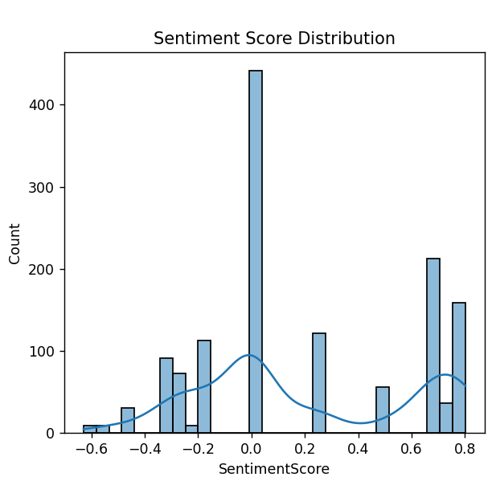
8. Initial visual representation of key findings
No review texts were removed; outliers informed filtering strategy.
Flagged extreme sentiment scores below -0.5 or above 0.5 using buckets.

Slide 10
THANK YOU!

